Slide 1
Minimum Spanning Trees
Longin Jan Latecki
Temple University
based on slides by
David Matuszek, UPenn,
Rose Hoberman, CMU,
Bing Liu, U. of Illinois,
Boting Yang, U. of Regina

Slide 2
Problem: Laying Telephone Wire
Central office

Slide 3
Wiring: Naive Approach
Central office
Expensive!

Slide 4
Wiring: Better Approach
Central office
Minimize the total length of wire connecting the customers

Slide 5
Minimum-cost spanning trees
Suppose you have a connected undirected graph with a weight (or cost) associated with each edge
The cost of a spanning tree would be the sum of the costs of its edges
A minimum-cost spanning tree is a spanning tree that has the lowest cost
16
16
A
B
A
B
21
11
6
11
6
19
5
5
F
C
F
C
33
14
10
E
18
D
E
18
D
A connected, undirected graph
A minimum-cost spanning tree

Slide 6
Minimum Spanning Tree (MST)
A minimum spanning tree is a subgraph of an undirected weighted graph G, such that
it is a tree (i.e., it is acyclic)
it covers all the vertices V
  contains |V| - 1 edges
the total cost associated with tree edges is the minimum among all possible spanning trees
not necessarily unique

Slide 7
Applications of MST
Any time you want to visit all vertices in a graph at minimum cost (e.g., wire routing on printed circuit boards, sewer pipe layout, road planning…)
Internet content distribution
  $$$, also a hot research topic
  Idea: publisher produces web pages, content distribution network replicates web pages to many locations so consumers can access at higher speed
  MST may not be good enough!
    content distribution on minimum cost tree may take a long time!
Provides a heuristic for traveling salesman problems. The optimum traveling salesman tour is at most twice the length of the minimum spanning tree (why??)

Slide 8
How Can We Generate a MST?
9
b
9
b
a
2
6
a
2
6
d
d
4
5
4
5
5
4
5
4
5
e
5
e
c
c

Slide 9
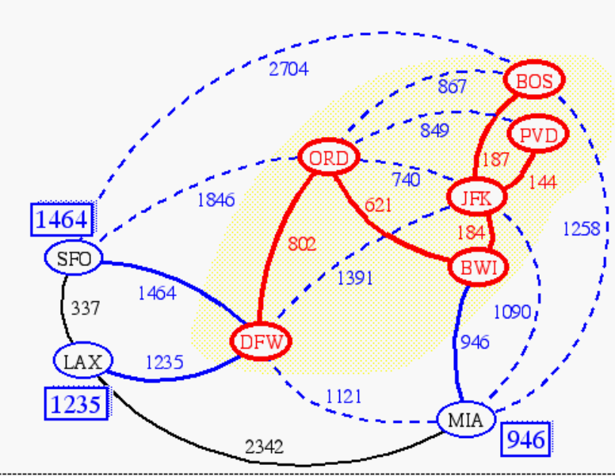
Prim(-Jarnik)’s Algorithm
Similar to Dijkstra’s algorithm (for a connected graph)
We pick an arbitrary vertex s and we grow the MST as a cloud of vertices, starting from s
We store with each vertex v a label d(v) = the smallest weight of an edge connecting v to a vertex in the cloud
At each step:
  We add to the cloud the vertex u outside the cloud with the smallest distance label
  We update the labels of the vertices adjacent to u

Slide 10
Prim’s algorithm
T = a spanning tree containing a single node s;
E = set of edges adjacent to s;
while T does not contain all the nodes {
  remove an edge (v, w) of lowest cost from E
  if w is already in T then discard edge (v, w)
  else {
    add edge (v, w) and node w to T
    add to E the edges adjacent to w
  }
}
An edge of lowest cost can be found with a priority queue
Testing for a cycle is automatic
  Hence, Prim’s algorithm is far simpler to implement than Kruskal’s algorithm (presented below)

Slide 11
Example
∞
7
2
7
D
2
7
D
B
4
B
4
8
9
∞
5
9
∞
2
5
F
2
5
F
C
8
C
8
8
3
8
3
E
E
A
7
7
A
7
7
0
0
7
7
2
7
D
7
D
B
4
2
B
4
5
9
∞
9
4
2
5
F
5
5
C
2
F
8
C
8
8
3
3
E
8
A
7
E
0
7
A
7
7
0

Slide 12
Example (contd.)
7
2
7
D
B
4
5
9
4
2
5
F
C
8
8
3
E
A
7
3
7
0
7
D
2
B
4
5
9
4
2
5
F
C
8
8
3
E
A
7
3
0

Slide 13
Prim’s algorithm
Vertex Parent
e -
b -
c -
d -
e
d
b
c
a
0
∞
∞
∞
∞
9
b
a
2
6
d
4
5
Vertex Parent
e -
b e
c e
d e
5
4
d
b
c
a
5
e
c
4
5
5
∞
The MST initially consists of the vertex e, and we update
the distances and parent for its adjacent vertices

Slide 14
Prim’s algorithm
Vertex Parent
e -
b e
c e
d e
d
b
c
a
4
5
5
∞
9
b
a
2
6
d
4
5
5
4
Vertex Parent
e -
b e
c d
d e
a d
5
e
c
a
c
b
2
4
5

Slide 15
Prim’s algorithm
Vertex Parent
e -
b e
c d
d e
a d
a
c
b
2
4
5
9
b
a
2
6
d
4
5
5
4
5
e
c
Vertex Parent
e -
b e
c d
d e
a d
c
b
4
5

Slide 16
Prim’s algorithm
Vertex Parent
e -
b e
c d
d e
a d
c
b
9
b
4
5
a
2
6
d
4
5
5
4
5
e
Vertex Parent
e -
b e
c d
d e
a d
c
b
5

Slide 17
Prim’s algorithm
Vertex Parent
e -
b e
c d
d e
a d
b
5
9
b
a
2
6
d
4
5
5
4
5
e
c
Vertex Parent
e -
b e
c d
d e
a d
The final minimum spanning tree

Slide 18
Prim’s Algorithm Invariant
At each step, we add the edge (u,v) s.t. the weight of (u,v) is minimum among all edges where u is in the tree and v is not in the tree
Each step maintains a minimum spanning tree of the vertices that have been included thus far
When all vertices have been included, we have a MST for the graph!

Slide 19
Correctness of Prim’s
This algorithm adds n-1 edges without creating a cycle, so clearly it creates a spanning tree of any connected graph (you should be able to prove this).
But is this a minimum spanning tree?
Suppose it wasn't.
There must be point at which it fails, and in particular there must a single edge whose insertion first prevented the spanning tree from being a minimum spanning tree.

Slide 20
Correctness of Prim’s
Let G be a connected, undirected graph
Let S be the set of edges chosen by Prim’s algorithm before choosing an errorful edge (x,y)
x
y
Let V(S) be the vertices incident with edges in S
Let T be a MST of G containing all edges in S, but not (x,y).

Slide 21
Correctness of Prim’s
w
v
Edge (x,y) is not in T, so there must be a path in T from x to y since T is connected.
Inserting edge (x,y) into T will create a cycle
x
y
There is exactly one edge on this cycle with exactly one vertex in V(S), call this edge (v,w)

Slide 22
Correctness of Prim’s
Since Prim’s chose (x,y) over (v,w), w(v,w) >= w(x,y).
We could form a new spanning tree T’ by swapping (x,y) for (v,w) in T (prove this is a spanning tree).
w(T’) is clearly no greater than w(T)
But that means T’ is a MST
And yet it contains all the edges in S, and also (x,y)
...Contradiction

Slide 23
Another Approach
Create a forest of trees from the vertices
Repeatedly merge trees by adding “safe edges” until only one tree remains
A “safe edge” is an edge of minimum weight which does not create a cycle
9
b
a
2
6
d
forest: {a}, {b}, {c}, {d}, {e}
4
5
5
4
5
e
c

Slide 24
Kruskal’s algorithm
T = empty spanning tree;
E = set of edges;
N = number of nodes in graph;
while T has fewer than N - 1 edges {
  remove an edge (v, w) of lowest cost from E
  if adding (v, w) to T would create a cycle
    then discard (v, w)
    else add (v, w) to T
}
Finding an edge of lowest cost can be done just by sorting the edges
Testing for a cycle: Efficient testing for a cycle requires a additional algorithm (UNION-FIND) which we don’t cover in this course. The main idea: If both nodes v, w are in the same component of T, then adding (v, w) to T would result in a cycle.

Slide 25
Kruskal Example
2704
867
BOS
849
PVD
ORD
187
740
144
1846
621
JFK
184
1258
802
SFO
BWI
1391
1464
337
1090
DFW
946
LAX
1235
1121
MIA
2342

Slide 26
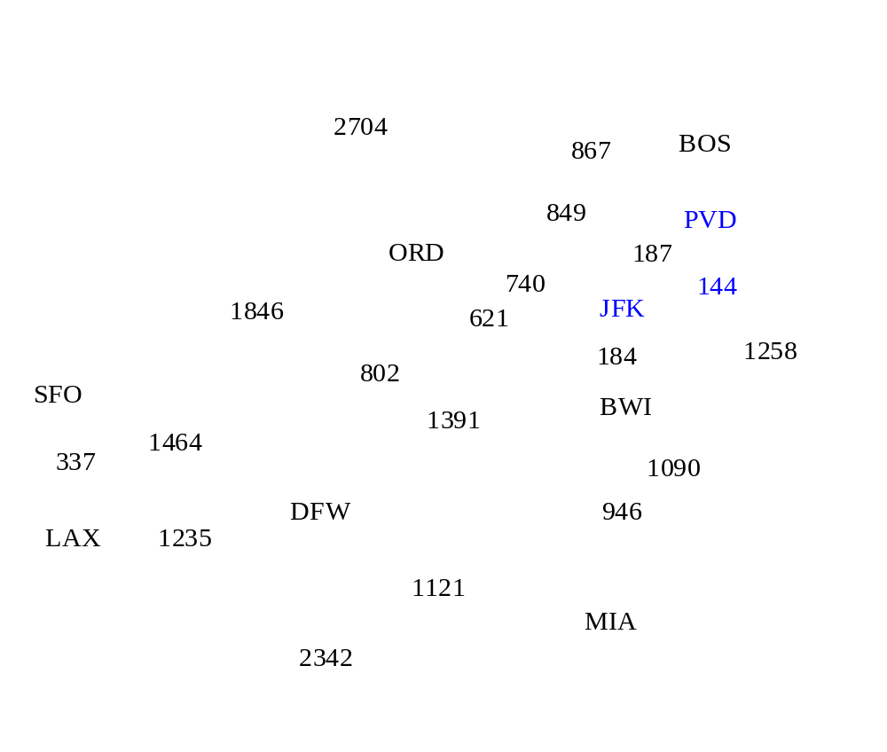
Example

Slide 27
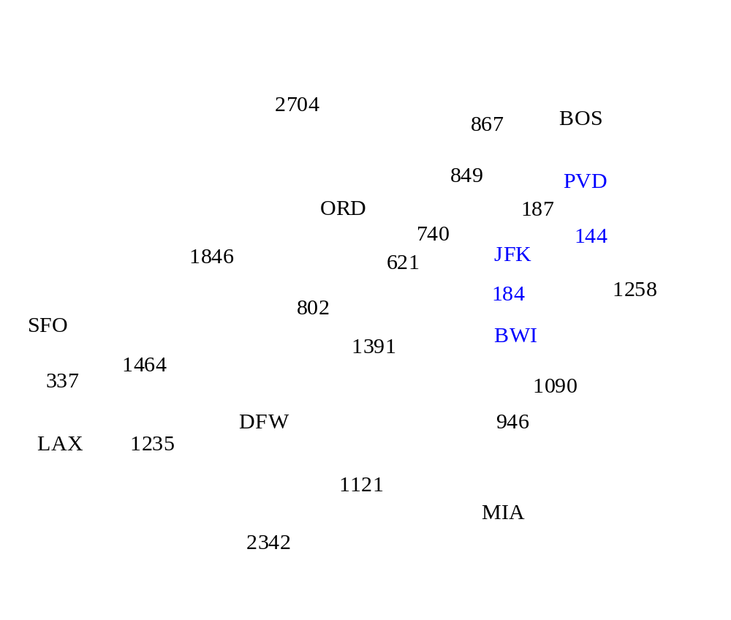
Example

Slide 28
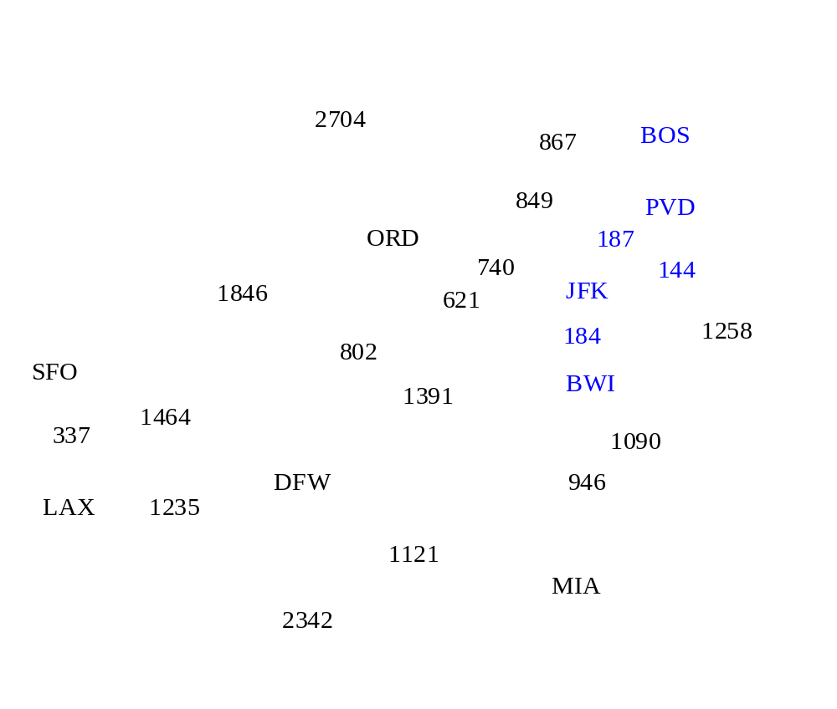
Example

Slide 29
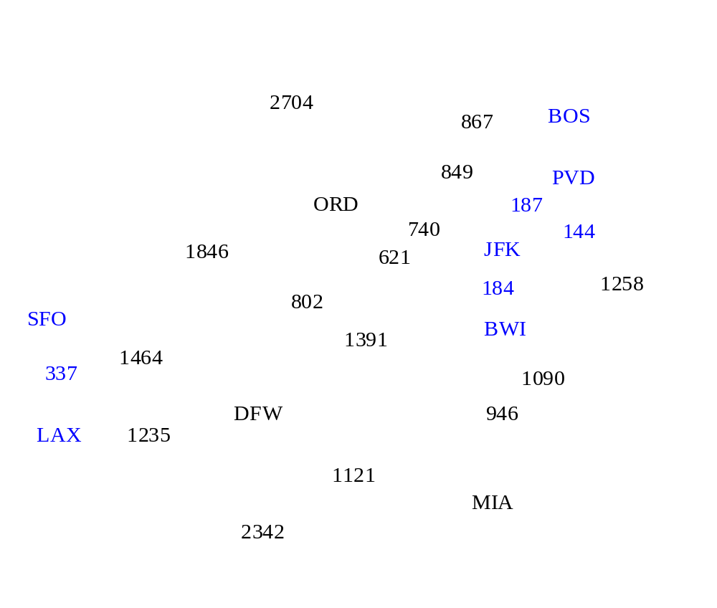
Example

Slide 30
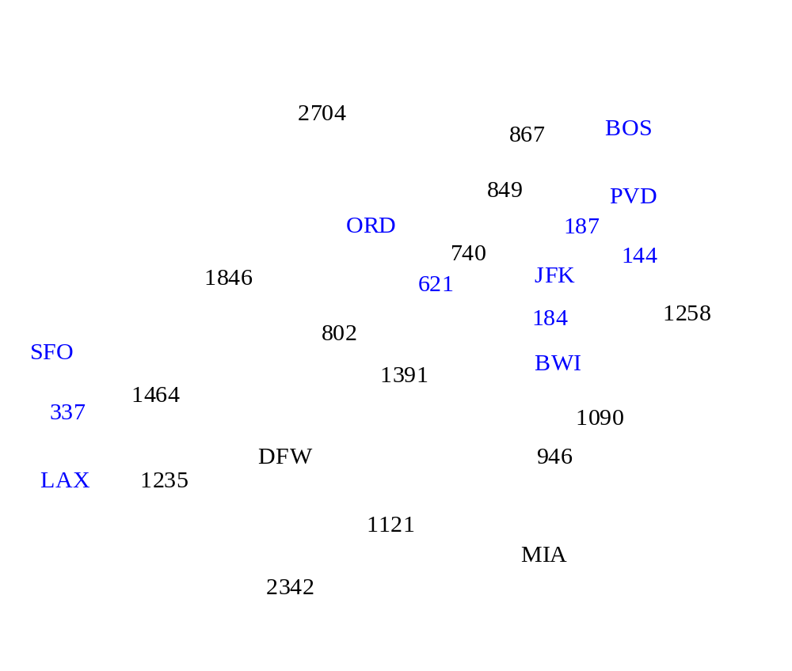
Example

Slide 31
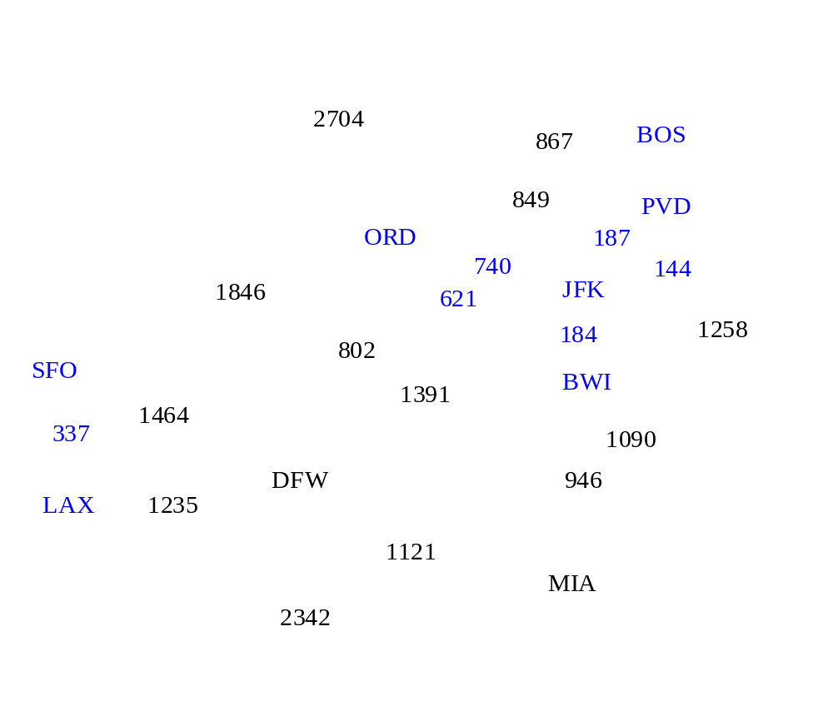
Example

Slide 32
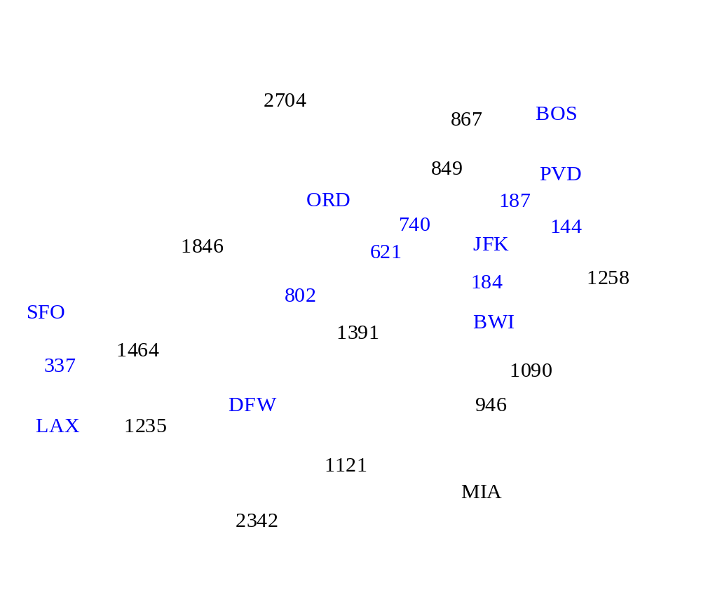
Example

Slide 33
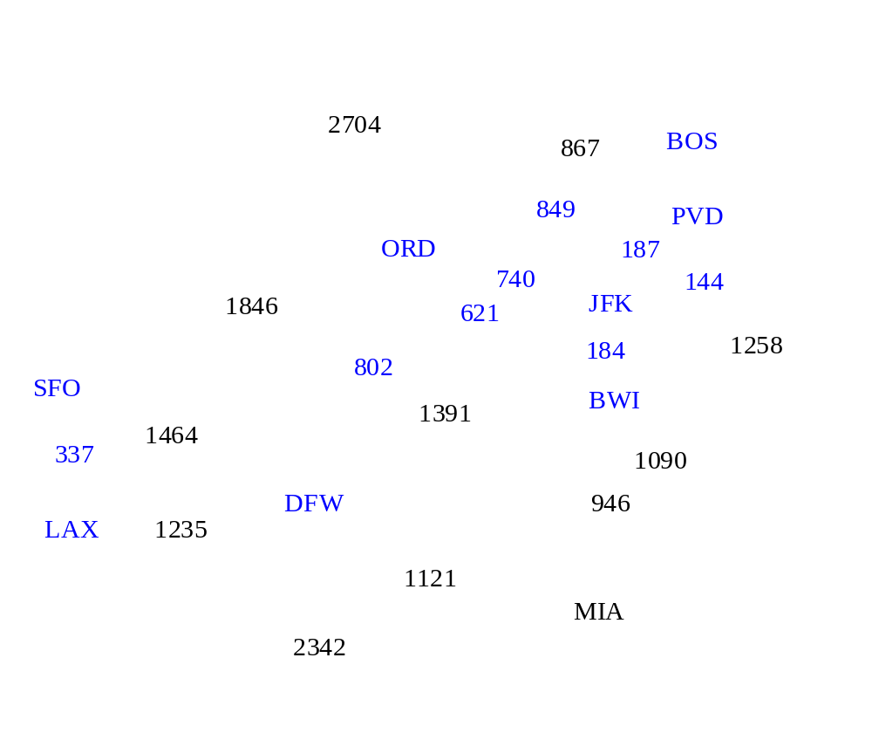
Example

Slide 34
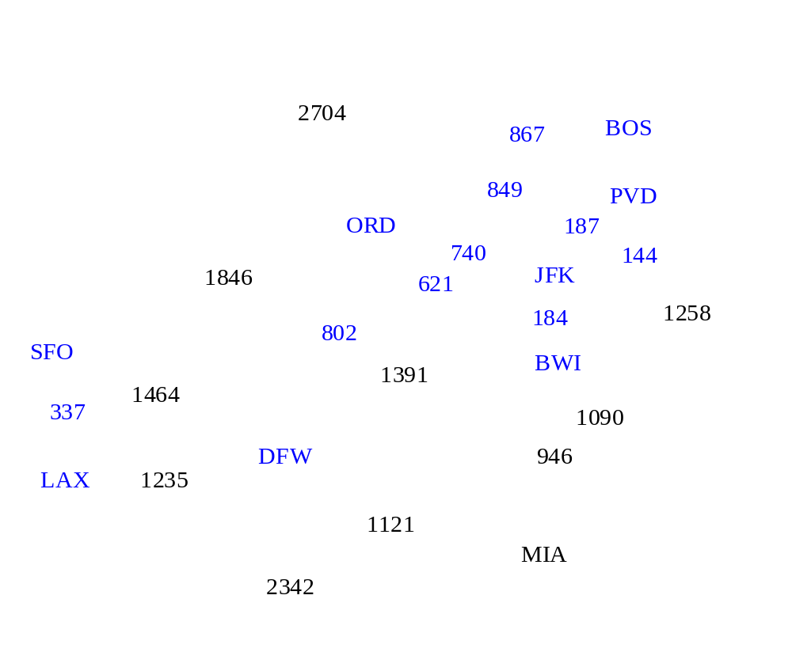
Example

Slide 35

Example

Slide 36
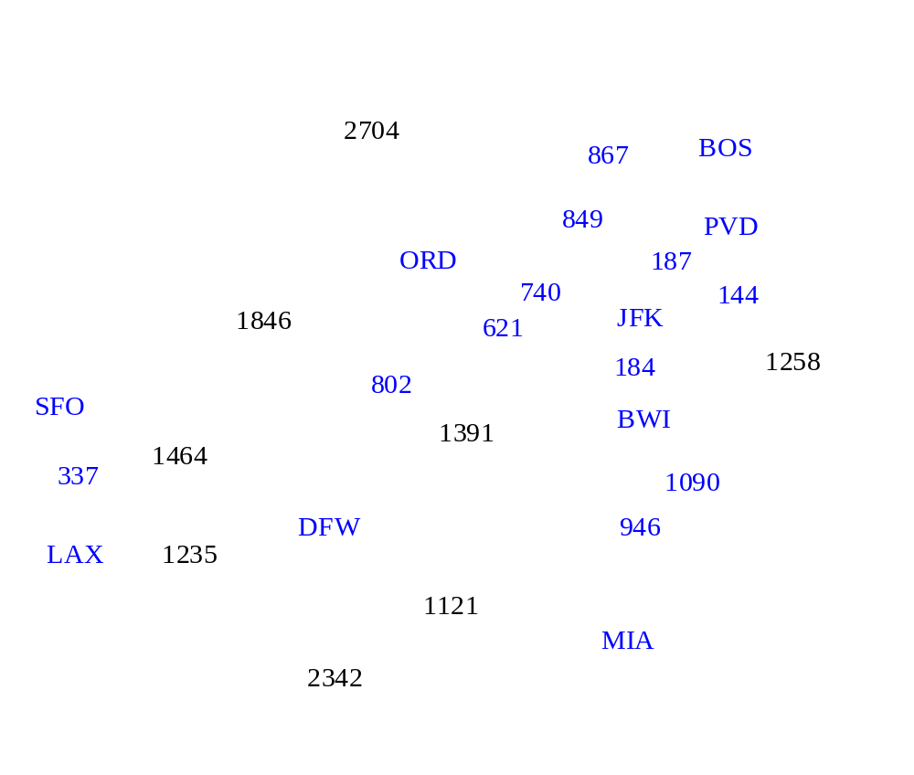
Example

Slide 37

Example

Slide 38
Example
2704
867
BOS
849
PVD
ORD
187
740
144
1846
621
JFK
184
1258
802
SFO
BWI
1391
1464
337
1090
DFW
946
LAX
1235
1121
MIA
2342

Slide 39
Time Compexity
Let v be number of vertices and e the number of edges of a given graph.
Kruskal’s algorithm: O(e log e)
Prim’s algorithm: O( e log v)
Kruskal’s algorithm is preferable on sparse graphs, i.e., where e is very small compared to the total number of possible edges: C(v, 2) = v(v-1)/2.

Slide 40
MST with Prim’s and Kruskal algorithm
4
a
2
b
3
c
5
5
4
2
1
2
d
e
f
3
3
1
3
g
7
h
5
i
4

